Slide 1
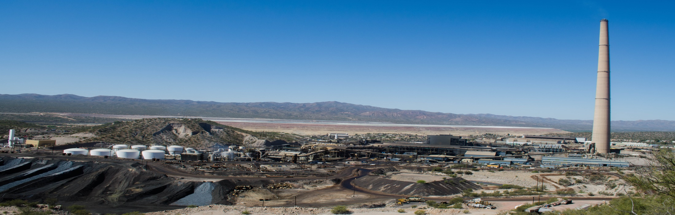


Airborne Lead & Arsenic in Hayden, AZ
REMAN Almusawi
Arizona Space Grant – 2020 Symposium
Acknowledgements: Dr. A.E. Sáez, Dr. E.A. Betterton, T. Rodriguez-Chavez, K. P. Rine, R. F. O’Brien-Metzger
Notes:
intro slide, point out picture as study side.. Myself & time I’ve been with lab.

Slide 2
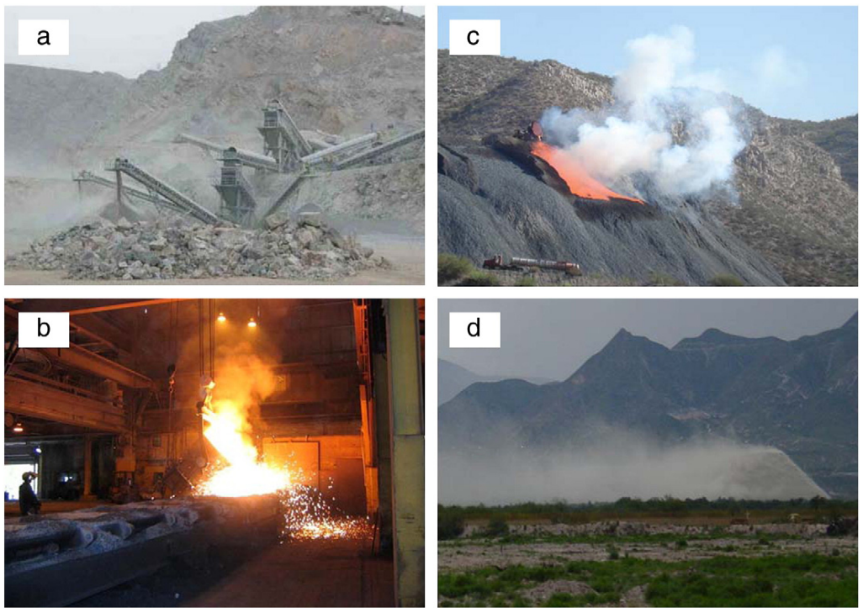
Introduction
A. CRUSHING & GRINDING
C. SLAG DUMPS
2008
ASARCO installed controls on refining operation - overall lead emissions reduced by 50%
Mandatory cleanups
2014
Nonattainment designation by EPA for airborne lead
2015
$150 million settlement between US EPA and ASARCO LLC
ASARCO mandated to install new equipment & pollution control technologies
B. SMELTING
D. WIND EROSION OF MINE TAILINGS
Source: Modified from (Csavina et al., 2012)
Notes:
Quickly go over mining operations, timeline, discuss $150 million settlement with EPA & ASARCO
A non-attainment area means air quality is worse than national air standards.

Slide 3
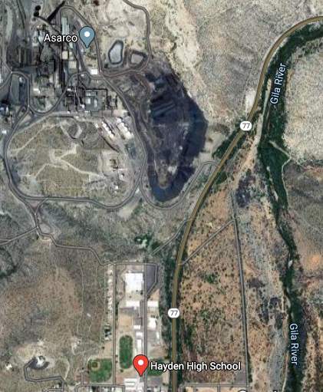
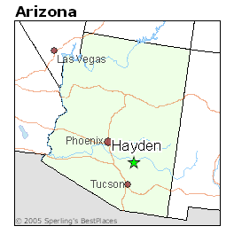
Study Site
Hayden High School
Notes:
Introduce study site as well as method (indoor vs. outdoor) Point out proximity of smokestack & slag pile to high school.. Discuss health effects of lead & arsenic

Slide 4

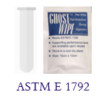
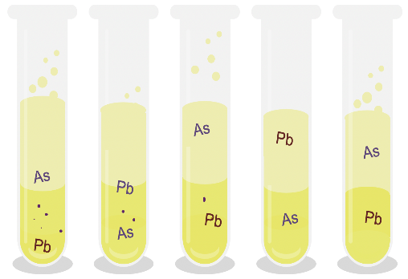

Materials & Methods
Inverted-disc samplers were installed at Hayden High School
Sample Preparation
Laboratory Analysis
22 Inverted-Disc Samplers
Diameter: 24 cm
Surface area : 0.045 m²
11 Surface wipe Samples
Template surface area : 0.03 m²
Extractions with 40 mL of Aqua Regia
Aliquot of 3.6 ml were diluted to 12 ml of D.I water
Samples were analyzed by The Arizona Laboratory for Emerging Contaminants (ALEC)
First Pass
Second Pass
Third Pass
Source: superfund.arizona.edu/personnel/trainees/tania-b-rodriguez
Notes:
Go over procedure – Inverted disk samplers & surface dust samplers

Slide 5
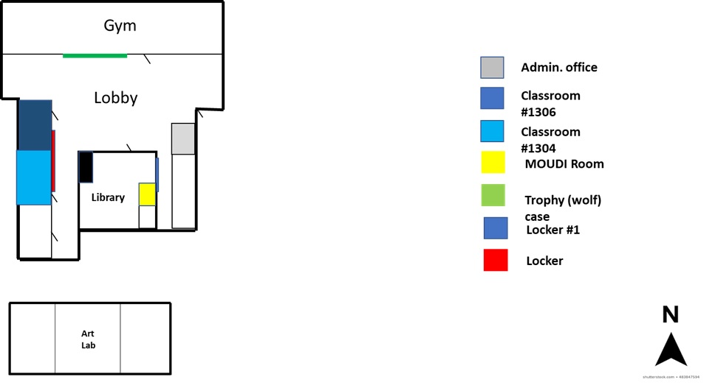
Source: superfund.arizona.edu/personnel/trainees/tania-b-rodriguez
Notes:
Plan View of where samples were placed.

Slide 6
Results: Inverted Disk Samplers
Source from T. Rodriguez; unpublished data
Notes:
Go over results, Explain Dust lead and lead deposition fluxes.. What do these numbers mean

Slide 7
Results: Surface Dust
Source from T. Rodriguez; unpublished data
Notes:
Go over results, collected one month before inverted disk samples were collected.. point out EPA standards line on left bar chart, some are exceeding.. There is no standard for Arsenic.. state that even though all don’t exceed standard even slightly elevated levels can be dangerous with chronic exposure.. No amount of lead or arsenic is safe for the human body.

Slide 8
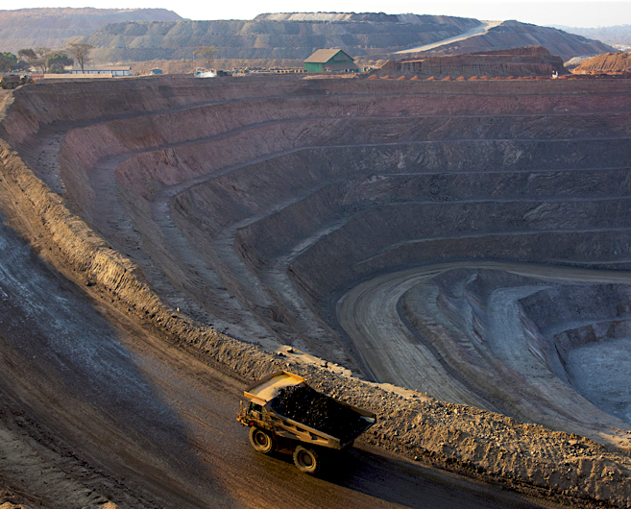
Conclusions
Lead particles make it into the indoor environments settling with dust
Previous studies show indoor particles to contain relatively elevated concentrations of lead.
Lead Dust > 108 μg/m²
EPA Dust-Lead Hazard Standard was violated

Slide 9


Thank You
Dr. Eduardo Sáez
Dr. Eric Betterton
Kyle Rine
Ruby O’Brien-Metzger
Tania Rodriguez-Chavez
Michelle Coe
Notes:
Thanksss everybody

Slide 10
References
Csavina, J., Field, J., Taylor, M. P., Gao, S., Landazuri, A., Betterton, E. A., & Sáez, A. E. (2012). A review on the importance of metals and metalloids in atmospheric dust and aerosol from mining operations. Science of the Total Environment, 433, 58-73.

